Slide 1
IT8811-Project work
AN IOT BASED FOREST FIRE DETECTION SYSTEM USING SENSORS , GSM & GPS MODULE
Project Team:
1.Saravanan K(312820205033)
2.Arunkumar G (312820205007)
Guided by
Mrs.T.Leonila
Assistant Professor
Dept of IT
Agni college of technology

Slide 2
Outline
Abstract
Objective and Scope
Introduction
Existing System
Proposed System
Block diagram
Hardware and Software Requirements
Methodology
Results and Conclusion
Future Works
References

Slide 3
Abstract
In the current era, ecosystem protection is a major problem. Now a days, the burning issue is damaging of natural vegetation, deforestation is one of them. Forest fire does more damage as compared to the damage done by the mankind for their own purposes.
Most of the times, when someone notice about the fire, it is too late because the fire has already spread. At that time taking precaution is just worthless.
That's why taking pre-safety measures is more beneficial. As technology has taken us to a new era, by implementing it we can preserve the floras and faunas and hence we can let the whole ecosystem work properly.
For the solution of this burning issue we designed a system based on GSM (Global System for Mobile Communication) & GPS (Global Positioning System) technology.
This system has interesting properties that make it useful for detection and prevention of forest fire. The intuitive description of this system is quite simple, can be implemented practically at a reasonable cost.

Slide 4
Objective and Scope of the Project
The objective of the project is to design and implement a comprehensive forest fire detection system utilizing GSM, GPS, and various sensors. The primary goal is to develop a proactive solution that can detect and alert authorities about potential forest fires in real-time, enabling prompt response and mitigation efforts.
The system will utilize GSM technology to transmit real-time alerts and data to designated authorities and stakeholders. GSM modules will be integrated into the system to enable seamless communication via SMS or GPRS, ensuring that timely alerts are sent to relevant parties upon detection of a forest fire.
The project will involve the integration of various sensors including temperature sensors to monitor ambient temperature, humidity sensors to measure humidity levels, smoke sensors to detect smoke particles, and fire sensors to identify flames. These sensors will be strategically placed across the forested area to ensure comprehensive coverage and early detection of fire incidents.
The system will continuously monitor environmental conditions using the integrated sensors and provide real-time alerts in the event of abnormal readings indicative of a potential fire outbreak. Alerts will be sent to designated recipients, including fire departments, emergency response teams, and forest management.

Slide 5
Introduction
Forest fires pose a significant threat to ecosystems, biodiversity, and human lives worldwide. Rapid detection and effective response are essential to mitigate their devastating impact. Traditional methods of fire detection often fall short in remote forested areas, necessitating the development of advanced technologies for early warning and intervention.
That's why taking pre-safety measures is more beneficial. As technology has taken us to a new era, by implementing it we can preserve the floras and faunas and hence we can let the whole ecosystem work properly.
he project encompasses the development of a comprehensive sensor network consisting of temperature, humidity, smoke, and fire sensors strategically deployed across forested areas. These sensors will continuously monitor environmental conditions and detect anomalies indicative of potential fire incidents. GSM technology will facilitate communication, while GPS modules will provide accurate location information for effective response coordination.
This system has interesting properties that make it useful for detection and prevention of forest fire. The intuitive description of this system is quite simple, can be implemented practically at a reasonable cost.

Slide 6
Existing System
Numerous solutions have been proposed and implemented for this problem. Most common systems used in field work are video surveillance systems. Video cameras are sensitive to smoke only in day time.
Fire sensitive cameras at night, using IR thermal imaging cameras for heat flux detecting and using backscattering of laser light, detect the smoke particles.
This fire alert system has a few limitations because of environmental conditions like dust particles, mist, shadows and so on. Another method is automated picture capturing of fires in forest. Capturing can be done by the cameras which are placed on top of towers.
A motor was introduced to give a coverage view on the forest and for its movement (Basu et al., 2018). Captured pictures are processed using program or MATLAB simulation and matching with references taken at beginning stage.

Slide 7
Proposed System
Fire Security is primary concern for everyone. Individuals, industries, home appliances are taking general precaution about fire safety. But forest fire monitoring always in less priority.
The main aim of this project is to continuously monitor the forest from fire accidents occur, the system should alert the siren and also inform immediately to the person concerned by using wireless communication system GSM.
This system totally eliminates a person who has to monitor the house or industry all the time. Here we proposed solution like forest fire monitoring system using GSM

Slide 8
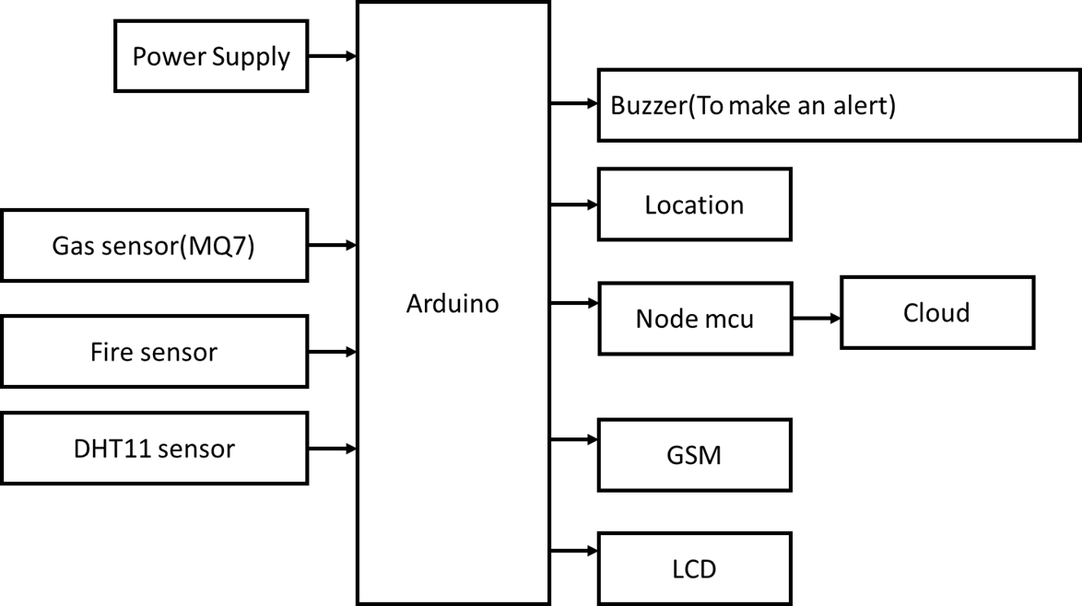
BLOCK DIAGRAM

Slide 9
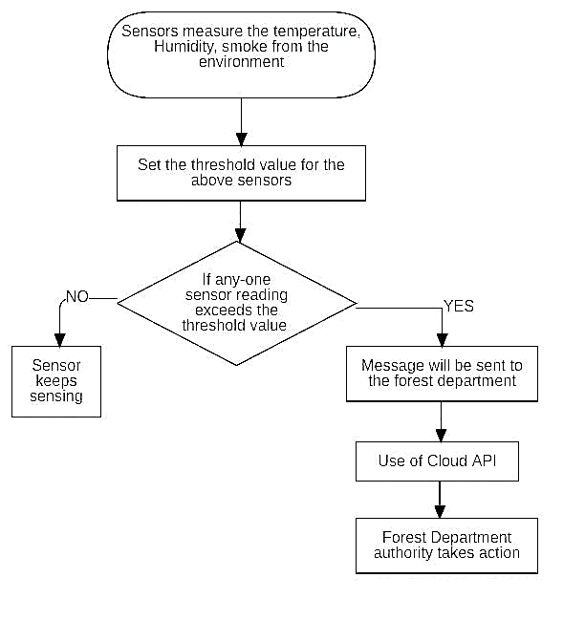
FLOW CHART

Slide 10
Hardware and Software Requirements
SOFTWARE REQUIREMENTS:
Arduino IDE
Embedded c programming
Proteus software
HARDWARE REQUIREMENTS:
Arduino
Node mcu
Gas sensor(MQ-7)
Fire sensor
DHT-11 sensor
Buzzer
GSM
GPS

Slide 11
Methodology
Research and Requirements Gathering:
Conduct thorough research on existing forest fire detection systems, technologies, and relevant literature.
Gather requirements from stakeholders, including forest authorities, firefighters, and potential end-users.
System Design:
Design the architecture of the forest fire detection system, considering the integration of GSM, GPS, and sensor technologies.
Define the specifications for the sensor network, data processing unit, GSM module, GPS module, central monitoring system, user interface, and automatic response mechanisms.
Create a detailed system design document outlining the components, interactions, and interfaces.
Sensor Selection and Deployment:
Select appropriate sensors for detecting environmental parameters such as temperature, humidity, smoke, and possibly infrared.
Determine the optimal locations for sensor deployment within the forested areas based on factors such as fire risk, coverage area, and accessibility.

Slide 12
Methodology
Integration and Testing:
Integrate the hardware and software components to form the complete forest fire detection system.
Conduct thorough testing of the system in simulated and real-world environments to ensure functionality, reliability, and accuracy.
Perform integration testing to verify the interoperability of different modules and components.
Deployment and Maintenance:
Deploy the forest fire detection system in targeted forested areas, ensuring proper installation and configuration.
Establish a maintenance plan for ongoing system monitoring, troubleshooting, and updates.
Provide technical support and assistance to users as needed.

Slide 13
Results
Measure the system's ability to detect forest fires accurately and in a timely manner. Evaluate the system's sensitivity to various environmental factors such as temperature, humidity, and smoke.
When the current or load increases, or when heat was detected by the sensor then it automatically display the message on a LCD which is connected in the driver room and buzzer sounds which indicating loco to halt the train immediately.
Assess the time taken from fire detection to alerting the appropriate authorities or triggering automatic response mechanisms. Aim for minimal response times to enable swift action and containment of fires.
Measure the impact of the forest fire detection system on mitigating fire damage by enabling early intervention and rapid response. Compare historical data on fire incidents and their extent of damage before and after implementing the system.

Slide 14
Future work
Wireless sensor network are increasingly applied in the field of fire safety and monitoring.
In addition, wireless sensor technology has a broad application background in the field of real time forest fire monitoring
If this type of project is implemented by the Government then many lives can be saved including humans and animals as well as valuable trees.
It can also save capitals, time and manpower. Implementation of this project can solve many of the environmental issues

Slide 15
Conclusion
We have used two modules: one for fire detection with the help of Gas sensor (MQ-7) and the other is for the location, humidity condition and temperature.
Here we used one alarm near to fire so as the fire detected in that area fire alarm will give the sound and alert the animals and people working there to leave that place safely.
GPS and gas sensor is synchronized in such a way that as the gas sensor detects the fire GPS will send its location along with the gas sensor reading.
This data will be send by GSM sensor and receive by GSM sensor on the receiving side and then to data base in this way we can protect our wildlife, forest and people working there before fire occurs.
New technologies and concepts developed in such as advanced multi- function sensors, computer vision systems and wireless sensors, real-time control via the Internet , and integrated building service systems.

Slide 16
References
[1] Alexander A. Khamukhin et al: Aerial Forest Fire Surveillance - Evaluation of Forest Fire Detection Model using Aerial Videos,” Future Genre. Compute. Syst., vol. 29, no. 7, pp. 1645–1660, Sep. 2018.
[2] Shixiao Wu et al, “Speculation of Forest Fire Using Spatial and Video Data”, 2019 4th IEEE Conf. Ind. Electron. Appl. ICIEA 2009, pp. 520–523, 2018.
[3] Evizal Abdul Kadir et al, “Modeling of Wireless Sensor Networks for Detection Land and Forest Fire Hotspot,” Int. J. Distrib. Sens. Netw., vol. 2019, no. March, 2019.
[4] The Zettabyte Era-Trends and Analysis. Cisco, May 2013. [Online]. Available: http://www.cisco.com/en/US/solutions/collateral/ns341/ns52 5/ ns537/ns705/ns827/VNI_Hyperconnectivity_WP.html

Slide 17
Thank You

